Slide 1
You Can’t Pour From An Empty Vessel
Radical self-care for the Matriarchs who carry our Nations

Slide 4
“You Make Me Want To Be A Better Man”

Slide 6
Balance

Slide 7
Emotional labor, as I define it, is emotion management and life management combined.
It is the unpaid, invisible work we do to keep those around us comfortable and happy.

Slide 10
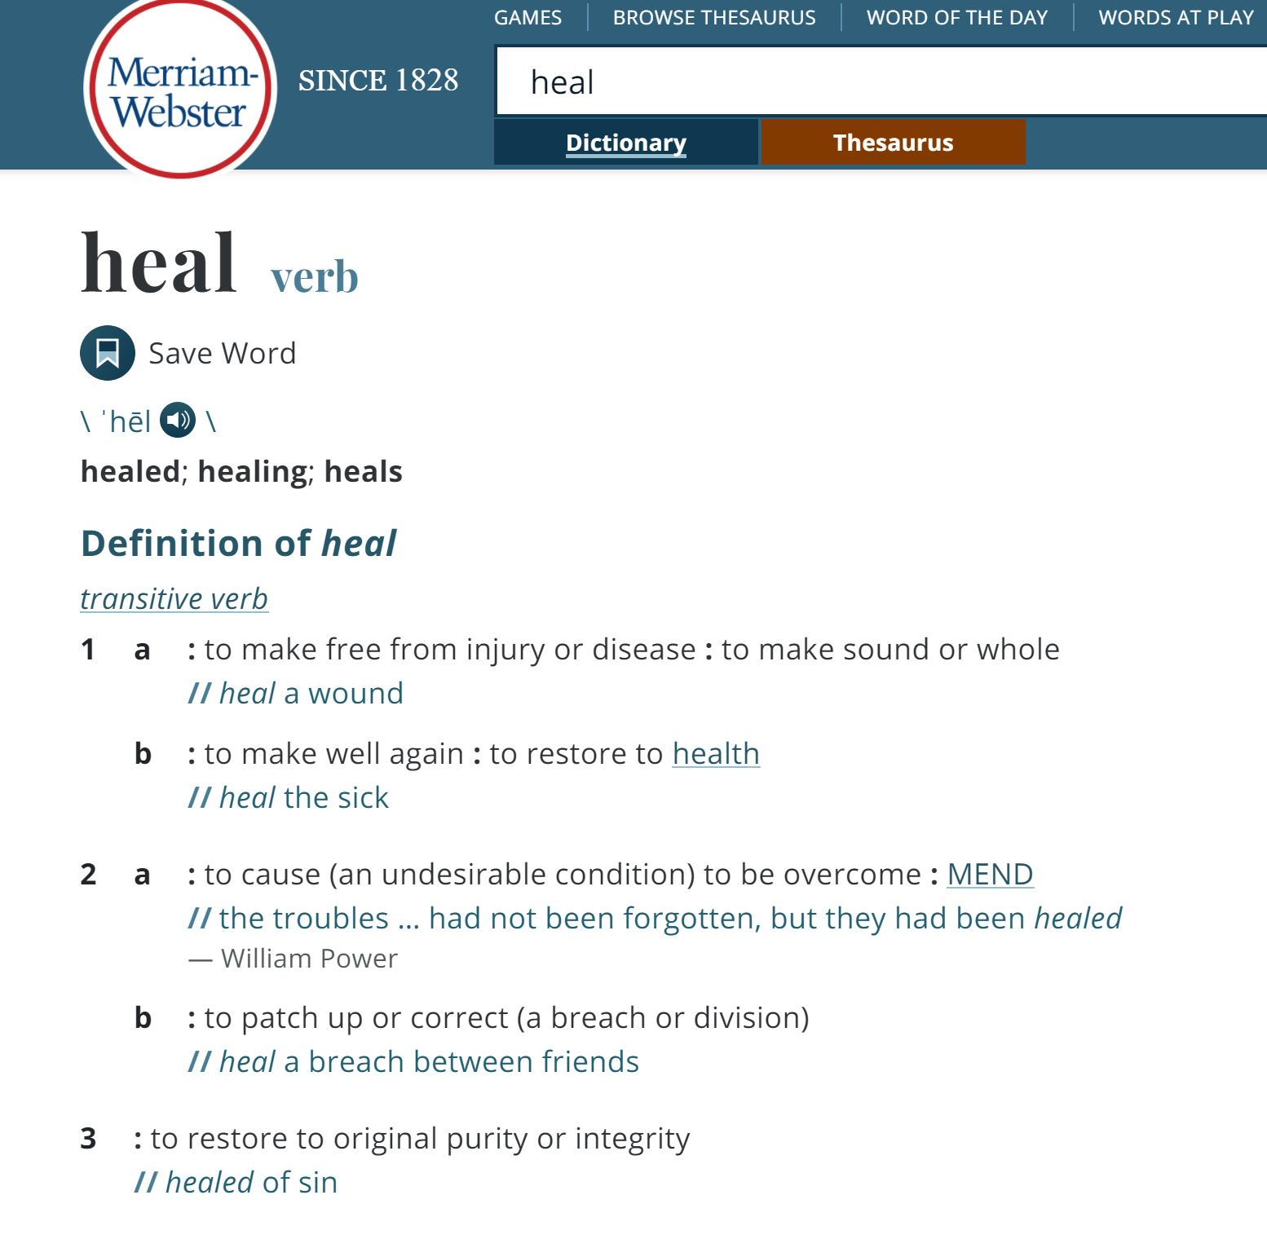
What is Healing?

Slide 11
There are Many Levels of Healing
Nation
Community
Family
Self
Healer
Helper
Victim
Survivor

Slide 13
Healing from Trauma
No Anger: Focused on changing or dismantling systems that perpetuate the root causes
Healer
Lots of Anger: No focus, can be directed at anyone including themselves
Less Anger: Focused on preventing similar harm on others
Helper
Victim
Survivor
Caregiver at risk due to smoldering anger
Still Anger: Focus on person(s)who harmed them

Slide 15
Environmental Factors
Things that empty your vessel

Slide 16
The Problem
Child apprehensions, teen pregnancies, single female parents, discriminatory policies. Child raised outside of family, community, nation = loss of identity
Breakdown in Families
Intergenerational Trauma
Poverty
Inadequate Housing
Health Crisis
Over Incarceration
Repeated generations suffering from abuse means trauma becomes encoded in our DNA.
We come to prefer strife over happiness. We self sabotage.
Inadequate education coupled with racism means fewer job opportunities. Successful programs do not receive sustainable funding.
Inadequate funding means a shortage of houses and leadership trying to make do with less. Urban migration = culture shock
Poverty = poor health however few access due to historical mistrust re: involuntary sterilizations, drug testing, birth alerts, etc.
People committing property/survival offences jailed. Do not receive adequate representation. Do not get bail. Jail leads to exposure to a broader criminal element.

Slide 17
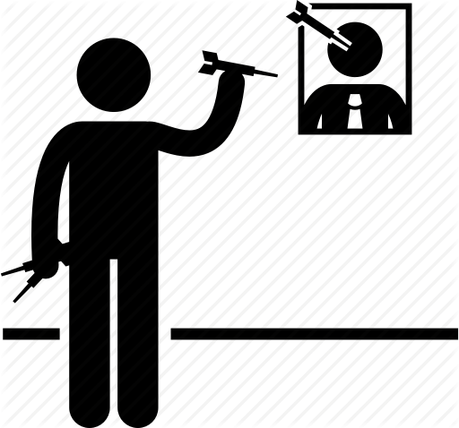
The Problem for Indigenous Agencies
Increased employee absence from the workplace, high turnover of staff, employees doing the bare minimum
VICARIOUS TRAUMA (Burnout)
LATERAL VIOLENCE
Poor Morale
Employees with Intergenerational Trauma
Inadequate Screening & Training
Non-Indigenous Staff
Inadequate Screening & Training
Inadequate Managerial Responses
Indigenous employees will be at differing levels of recognition of the effects of this trauma and may or may not be actively involved in healing.
Indigenous staff may have appropriate education or experience for position, but some may not understand respectful workplace laws, have poor boundaries and poor work ethics.
Although the community & leadership may prefer exclusively Indigenous staff, the reality is that there is not enough qualified folks to fill demand.
Non-Indigenous staff not adequately trained in Indigenous worldview & communication. Worse yet, do not want to do any examination of their own privilege. Paternalism
Lack of leadership training, breakdowns in communications, unfamiliar with disciplinary documentation, no training budget

Slide 18
Vicarious trauma
an occupational challenge for people working and volunteering in the fields of victim services, law enforcement, emergency medical services, fire services, and other allied professions, due to their continuous exposure to victims of trauma and violence.

Slide 19
Vicarious trauma
This work-related trauma exposure can occur from such experiences as
listening to individual clients recount their victimization
looking at videos of exploited children
reviewing case files
hearing about or responding to the aftermath of violence and other traumatic events day after day
responding to mass violence incidents that have resulted in numerous injuries and deaths.

Slide 20
Long Term Effects of VT/STS
Over time, repeated exposure to difficult content can have a negative impact on our functioning and overall mental health, and it is important to develop a sense of our individual warning signs and develop tools to mitigate these negative effects.

Slide 21
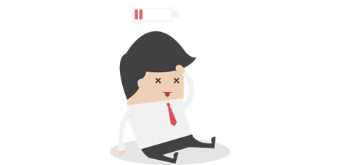
Physical Symptoms of VT/STS
Exhaustion
Insomnia
Headaches
Increased susceptibility to illness
Sore back and neck
Irritable bowel, GI distress
Rashes, breakouts
Grinding your teeth at night
Heart palpitations
Hypochondria

Slide 22
Behavioural Symptoms of VT/STS
Increased use of alcohol and drugs
Anger and Irritability at home and/or at work
Avoidance of clients/patients
Watching excessive amounts of TV/Netflix at night
Consuming high trauma media as entertainment
Not returning phone calls at work and/or at home
Avoiding colleagues and staff gatherings
Avoiding social events
Impaired ability to make decisions
Feeling helpless when hearing a difficult client story
Impostor syndrome – feeling unskilled in your job
Problems in personal relationships
Difficulty with sex and intimacy due to trauma exposure at work
Thinking about quitting your job (not always a bad idea by the way!)
Compromised care for clients/patients
Engaging in frequent negative gossip/venting at work
Focusing on how little a co-worker is doing and not enough on your own work
Impaired appetite or binge eating

Slide 23
Emotional Symptoms of VT/STS
Emotional exhaustion
Negative self-image
Depression
Increased anxiety
Difficulty sleeping
Impaired appetite or binge eating
Feelings of hopelessness
Guilt
Reduced ability to feel sympathy and empathy towards clients or family/friends
Cynicism at work
Anger at work
Resentment of demands being put on you at work and/or at home
Dread of working with certain clients/patients/certain case files
Diminished sense of enjoyment/career(i.e., low compassion satisfaction)
Depersonalization – spacing out during work or the drive home
Disruption of world view/heightened anxiety or irrational fears
Intrusive imagery
Hypersensitivity to emotionally charged stimuli
Insensitivity to emotional material/numbing
Difficulty separating personal and professional lives
Failure to nurture and develop non-work related aspects of life
Suicidal thoughts

Slide 24
Learning to Recognize Your Own Warning Signs Serves Two purposes
First, it can serve as an important check-in process for someone who has been feeling unhappy and dissatisfied, but does not have the words to explain what was happening to them.
Secondly, developing a warning system allows you to track your levels of emotional and physical depletion. It also offers you tools and strategies that you can implement right away.

Slide 25
What a warning system may look like:
If you were to learn to identify your CF/STS symptoms on a scale of 1 to 10 (10 being the worst you have ever felt about your work and 1 being the best that you have ever felt).
Then, you learn to identify what an 8 or a 9 looks like for you…
“When I’m getting up to an 8, I notice it because I don’t return phone calls, think about calling in sick a lot and can’t watch any violence on TV”
“I know that I’m moving towards a 7 when I turn down my best friend’s invitation to go out for dinner because I’m too drained to talk to someone else, and when I stop exercising.”

Slide 26
Coping Strategies
Being able to recognize that your level of CF/STS is creeping up to the red zone is the most effective way to implement strategies immediately before things get worse.
Perhaps when approaching an 8, you may not take on new clients with a trauma history, take a day off a week, or return to see a therapist

Slide 27
Personal Strategies to Combat VT
Physical – Physical activity to reverse the biological effects of stress on the body.
Mental – Doing something creative to stimulate the life side of your brain and distract you from the negativity.
Emotional – Spending time with those people who bring you joy. RELATIONSHIPS WILL ALWAYS GET YOU THROUGH
Spiritual – Partaking in that activity that grounds and centers you.

Slide 28
Medicine is much more than a pill!!!
Spirituality
Medicine for your Spirit
Medicine for your Heart
Medicine for your Body
Family/Friends
Physical Activity
Medicine for your Mind
Education

Slide 29
You are the medicine we need

Slide 30
Respecting Your Medicine
Being careful of what you put out to the universe
Respect Your Spirit
Do not play with others feelings.
Don’t let others play with yours
Respect Your Heart
Respect Your Body
Care of body and discarding body parts
Respect Your Mind
Teach and be taught

Slide 32
Melissa Sveinson Mobile: 204-898-3340 Email: Melissa.zaagiidiwin@gmail.com IG: @brownmidwife Cecil Sveinson Mobile: 204-470-7320 Email: cecilsveinson@gmail.com IG: @superneech

