Slide 1
Ontario Native Women’s Association
Presentation by: Michele Solomon and Monique DesRosiers

Slide 2
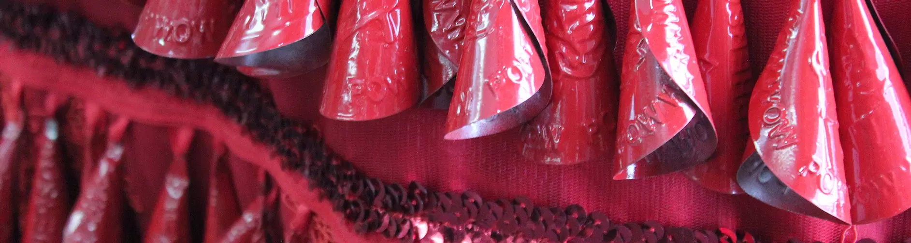
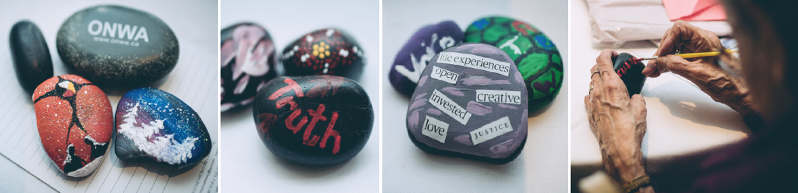
Reconciliation with Indigenous Women: Changing The Narrative: Missing and Murdered Indigenous Women and Girls

Slide 3
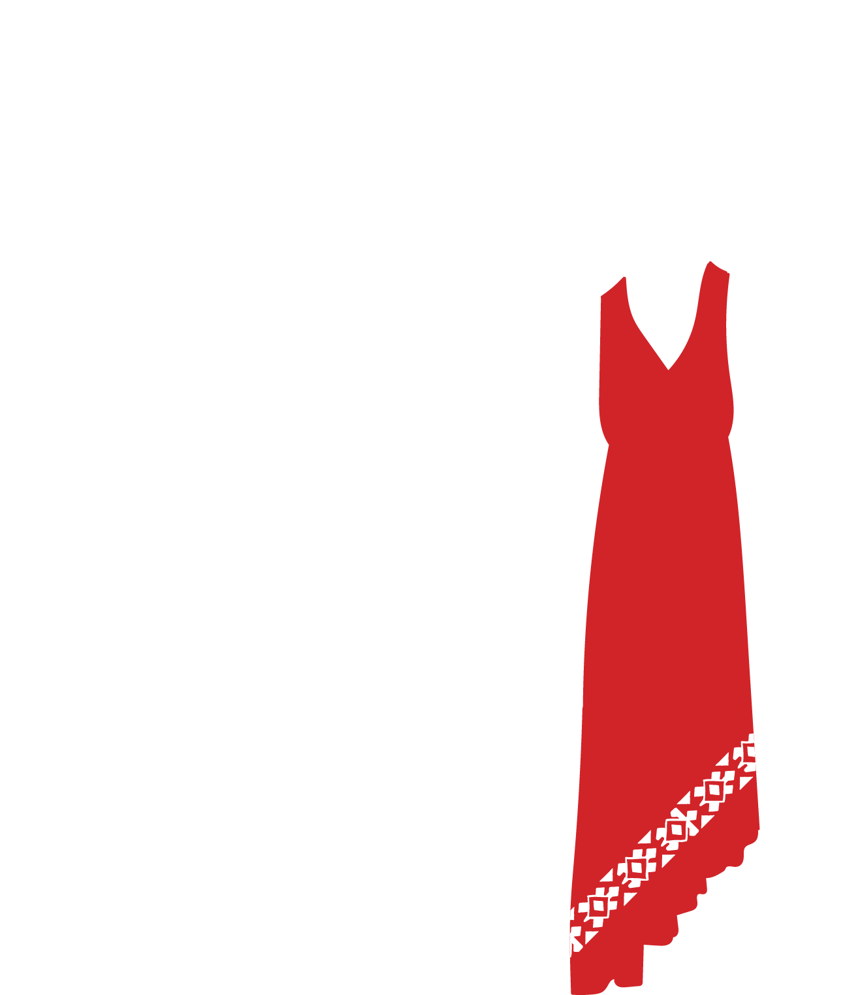
ONWA recognizes and honours families of Missing and Murdered Indigenous Women and Girls
Notes:
^{Acknowledgement from report:}
The Ontario Native Women’s Association (ONWA) would like to acknowledge all the courageous Indigenous women who spoke out on the violence they experienced, shared their stories about their families or lost loved ones, and bravely brought this issue to the forefront. We admire these women for their tireless grassroots efforts no matter how often they thought they were unheard. Much of the work of sharing stories, voices, and raising awareness outside of the National Inquiry was done without recognition or funding. Despite these challenges, Indigenous women continued to do the work.
Without the kindness and love of Elders, Knowledge Keepers, and healers who carried and supported Indigenous women throughout the process, the work could not have been completed. They reminded us to care for each other while we do the work because it is heavy and hard. Helpers reminded us that the way forward is through ceremony. Ceremony is a way that families find the healing needed to cope with the loss of their loved ones and honour the lives that have gone on. For many Indigenous peoples, ceremony is the answer to their many questions. The way we become whole again is by participating in ceremony to activate our healing journey from the historical and ongoing trauma rooted in violence against Indigenous women.
We want to acknowledge the many unrecognized Indigenous women leaders who guided us to this point to develop a National Action Plan that addresses the issue of Missing and Murdered Indigenous Women and Girls.

Slide 4
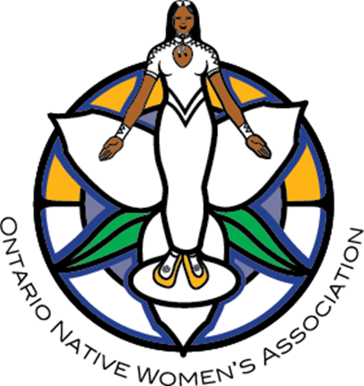
Acknowledging Our Ancestors of the Past, Present & Future
Been in existence since 1971 (51st year)
Led by strong Indigenous Women who have worked on addressing issues that Indigenous women experience
Focused on supporting women to take up their leadership roles in the family & in the community

Slide 5
Why Are we focused on Indigenous Women?
“Woman is the center of the wheel of life. She is the heartbeat of the people. She is not just in the home, but she is the community, she is Nation. One of our Grandmothers. The woman is the foundation on which Nations are built. She is the heart of her Nation. If that heart is weak the people are weak. If her heart is strong and her mind is clear then the Nation is strong and knows its purpose. The woman is the center of everything.”
- Art Solomon

Slide 6
The Journey
1980 Breaking Free; A Proposal for Change to Aboriginal Family Violence
2007 Summit to End Violence Against Aboriginal Women
2008-2015 A total of 5 summits focused on addressing violence
2015 TRC Calls to Action #41
2015 Announcement of the Inquiry
2019 The Final Report into Missing & Murdered Indigenous Women & Girls
2020 Reconciliation with Indigenous Women
2020 Indigenous Women’s Safety Table

Slide 7
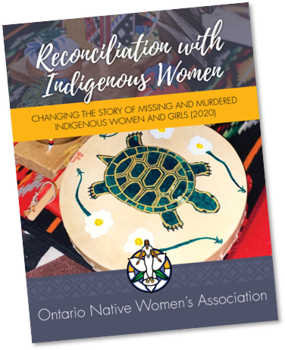
ONWA’s Report – Reconciliation with Indigenous Women
Released in 2020, the report outlines 13 key recommendations that ONWA maintains must be reflected in the National Action Plan.
https://www.onwa.ca/video-library
Notes:
The report was developed by and for Indigenous women, with the wise guidance of 1000s of Indigenous women’s voices throughout the years.
ONWA Closing Submission to the National Inquiry
From ONWA “Closing Submission to the National Inquiry into Missing and Murdered Indigenous Women and Girls” (p. 28 – Closing Statement)
In addressing the issue of missing and murdered Indigenous women and girls and creating solutions to address violence perpetrated against them, there needs to be a direct increase in responsibility and accountability at all levels of community agencies and government. It is time for leaders and policy makers to actively listen and empower the voices of Indigenous women and girls. As Indigenous women, we must take up our roles and responsibilities as leaders of communities. We must work collaboratively in order to develop effective solutions for change to occur. The Inquiry Commissioners need to be brave in carrying out their commitments to recommend actions that ensure the safety and security of Indigenous women and girls, now and in generations to come.
ONWA’s Recommendations to the National Inquiry
Restoration of Indigenous Women’s Identity - Sex Discrimination in the Indian Act
Restoration and Recognition of Indigenous Women’s Leadership
Language
Addressing Sexual Violence against Indigenous Women and Girls
Victim Services and Safety
Indigenous Women and the Gladue Principles
Addressing Human Trafficking Against Indigenous Women and Girls
Restoring Healthy Families and Addressing the Child Welfare System
Reinstatement of the Aboriginal Healing Foundation
Indigenous Gender Based Analysis
Investments in Indigenous Women’s Capacity and Leadership

Slide 8
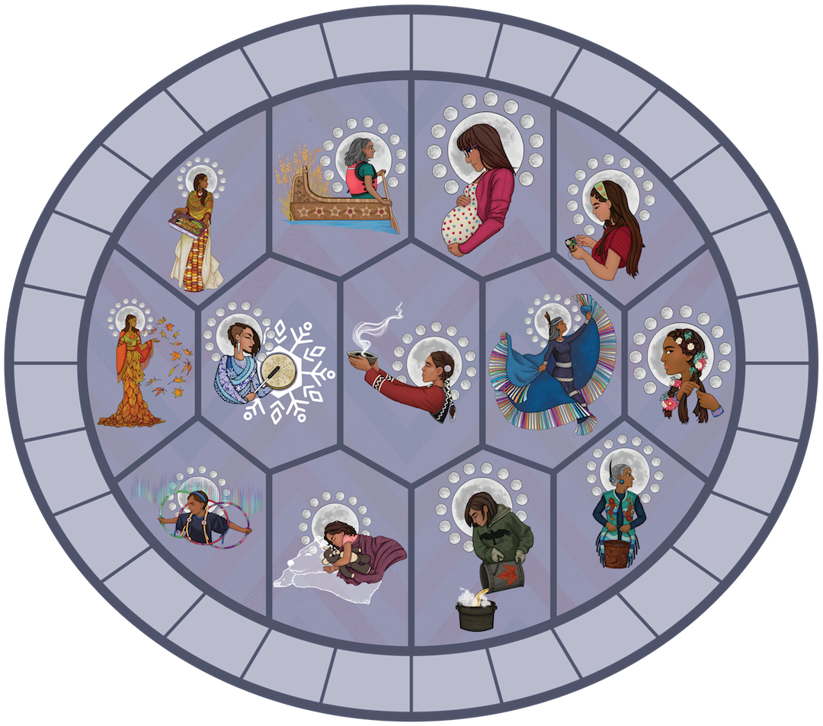
13 Grandmother
Moons

Slide 9
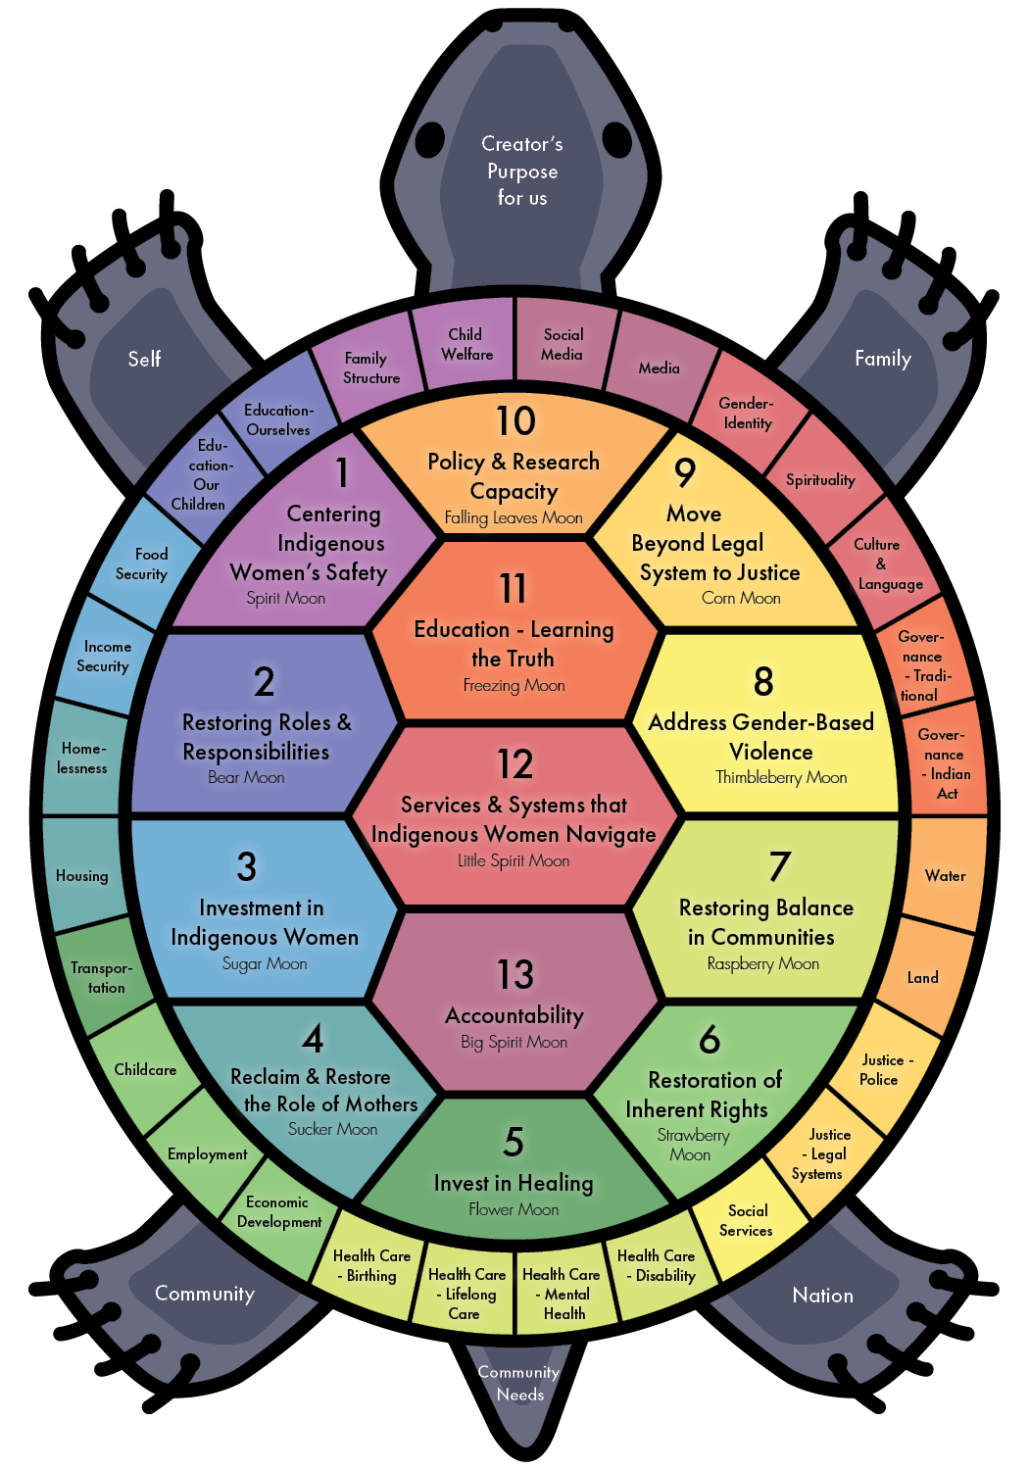
13 Grandmother Moon Recommendations
Notes:
13 recommendations to align with the 13 grandmother moons
1. The Safety of Indigenous Women must be at the center of the National Action Plan on Indigenous Women​
2. Restore Indigenous Women’s Roles and Responsibilities through the National Action Plan ​
3. Invest in Indigenous Women​ and Our Organizations​
4. Reclaim and Restore the Role of Indigenous Women as Mothers ​
5. Invest in Healing
6. Restoration of Indigenous Women’s ​Inherent Rights​
7. Restoring Balance within Communities​
8. Addressing the Many Forms of Violence that Indigenous Women and Girls Face​
9. Moving Beyond the Legal System to Justice
10. Policy and Research Capacity – ​Revealing the Story and Understanding of its Meaning​
11. Education – Learn the Truth​
12. Culturally-Appropriate Services and Systems that Indigenous Women Navigate​
13. Accountability

Slide 10
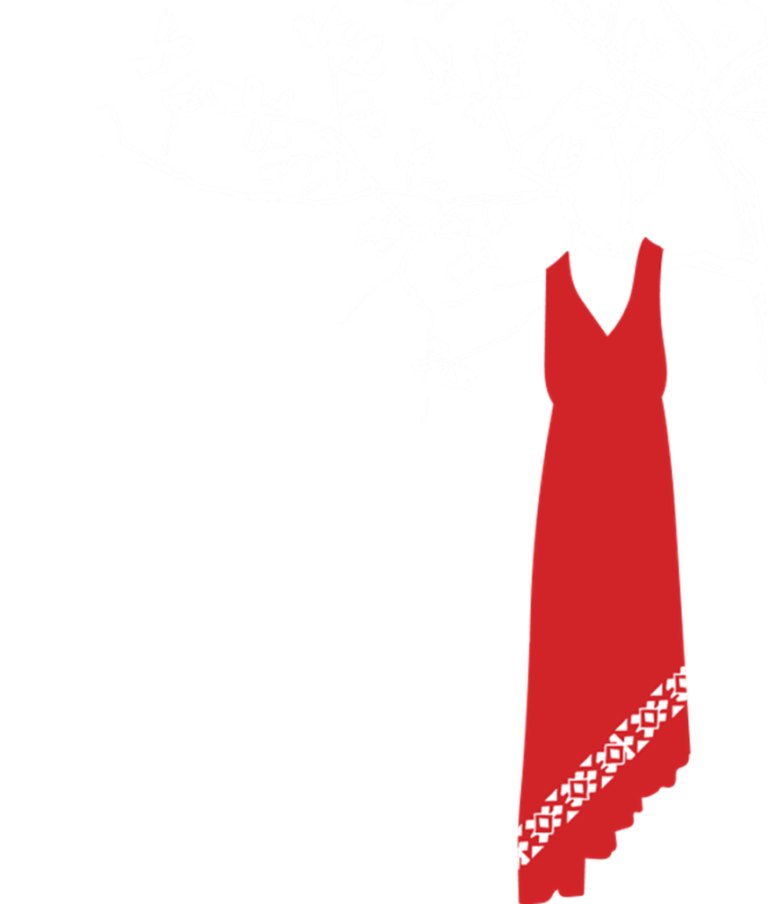
Indigenous Women’s Safety Table
The IWST is guided by the four following principles:
  The focus of the work for the IWST is on Indigenous women and girls.
  The application of an intersectional lens and Indigenous gender-based analysis occurs at every step of the process.
  A focus on Indigenous Women’s Safety and Healing is maintained throughout.
  The work is led and driven by Indigenous women and Indigenous women’s organizations.
Notes:
In response to the lack of representation of Indigenous women’s specific organizations at the National Action Plan’s development structure, ONWA worked to bring together a table comprised of Indigenous women with varying backgrounds of both professional and personal expertise in supporting Indigenous women.
The table will work to ensure that ONWA’s 13 recommendations from the Reconciliation with Indigenous Women Report are incorporated into the National Action Plan.
The table will also provide advice and guidance to the core working groups to help ensure all of the recommendations in the final version of the National Action Plan related to Indigenous women’s safety are implemented
The work is guided by the four following principles:
The focus of the work for the IWST is on Indigenous women and girls.
The application of an intersectional lens and Indigenous gender-based analysis occurs at every step of the process.
A focus on Indigenous Women’s Safety and Healing is maintained throughout.
The work is led and driven by Indigenous women and Indigenous women’s organizations.

Slide 11
MMIWG Work
Support families
Traditional Healing
Cultural reconnection
Create safe spaces
Bringing together families
Traditional healing
Notes:
The impact on family members has been tremendous. Each family that receives support is always very grateful for any help they receive in honouring their loved one. Families request to travel to events where their loved one was murdered or went missing, in hopes of finding something out or meeting someone who may know something. It is common for many families that access support from this program to continue to seek answers in what happened to their family member. But that information is not usually forthcoming. What comes instead is the building of a support system.
ONWA is honoured to be able to support families to gather, in doing so, they also find strength in each other’s messages. Attending events for Missing and Murdered Indigenous Women and Girls is crucial to their healing.
This fund has allowed families of Missing and Murdered Indigenous Woman and Girls to begin or continue the healing journey while carrying on the memory of their loved ones. Many family members that attend the events do so as the voice of their missing or murdered loved one. Through culture and ceremony, these families are developing bonds with others who know the experience, not only to support each other but also to walk hand in hand and work passionately to raise awareness to never let this happen to future generations. Many family members not have access to healing through culture, ceremony and understanding tradition.
Many services and programs are offered to assist these family members to take on a leadership role and be the voice of their loved one. Since services and gatherings are held provincially, most family members do not have the capacity to attend. If family members cannot attend, there is silence for the victims and a void in knowledge and awareness of the impact of this issue.
This funding has allowed the Ontario Native Women’s Association (ONWA) to help many families raise awareness through the programs and services we offer. Families are supported as they grieve and continue the grieving process. ONWA has supported families of Murder Victims and Missing Woman and Girls not only through service supports, also through voicing the concerns of family at a provincial, national and international level. ONWA has acknowledge that families are in need support to hold space for their pain through the use of traditional ceremony.
These days are moments in time and pass unknowingly for others, but for these families of MMIWG, time stops. This support is crucial to the family’s well-being. Each victim has a story, each family has their pain. MMIWG has become about not only telling the very human story of loss and grief, but also the story the families want us to know and hear, that of their loved one and who they were in this world and what their lives contributed to this world.
(see next slide)
MMIWG Quilt
Annual MMIWG Pow Wow (Thunder Bay)
MMIW Quarterly Feast
Annual Poetry Night (Nov. 25 – UN International Day of Elimination of Violence Against Women) (Strong Hands Stop Violence)

Slide 12
Inspiration:
Other exhibits honouring the lives of Missing and Murdered Indigenous Women and Girls and their family and loved ones.

Slide 13
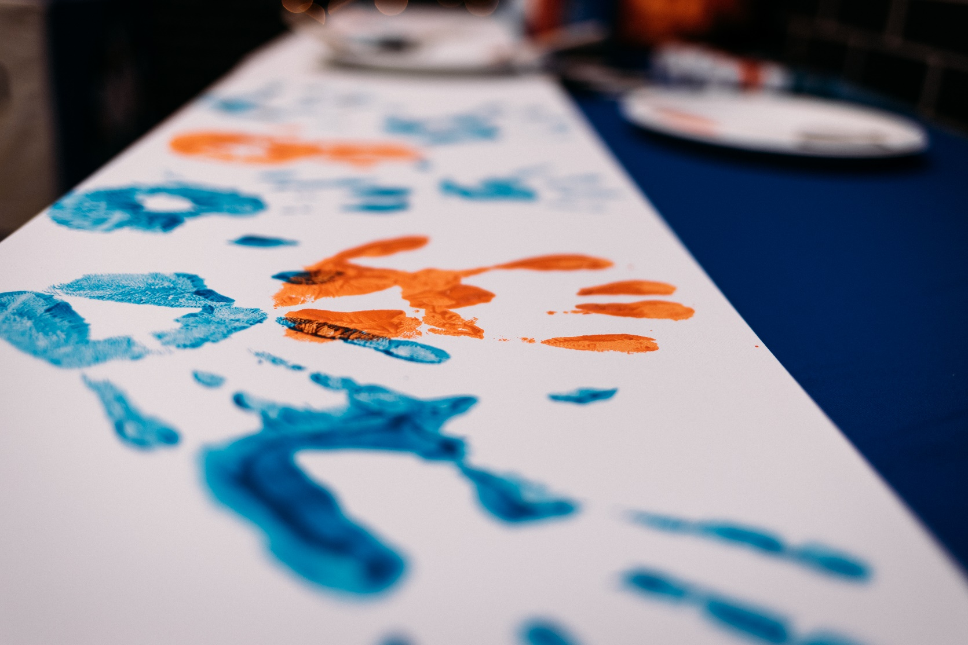
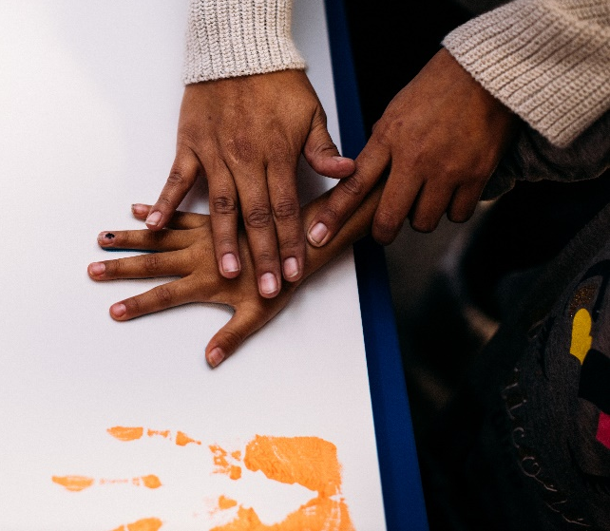
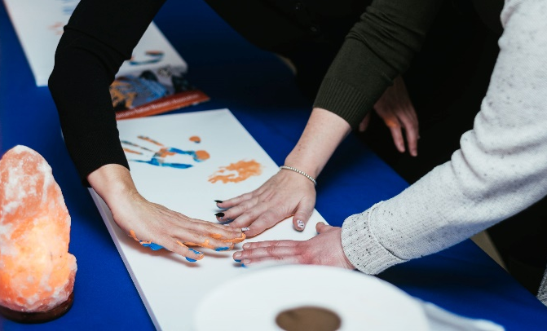
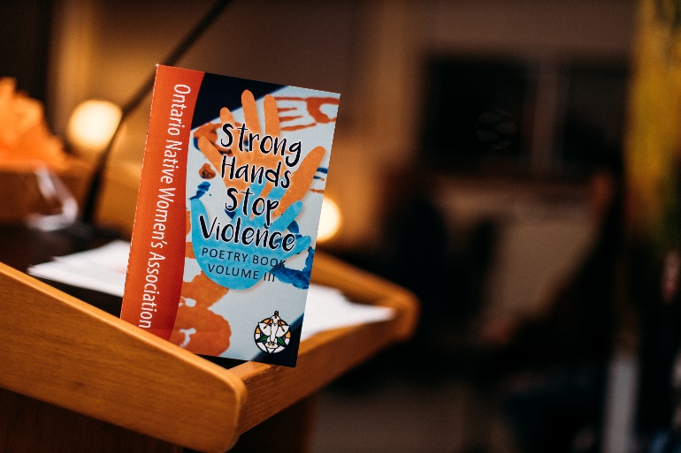

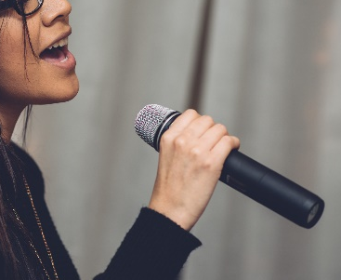
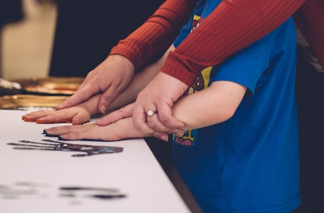
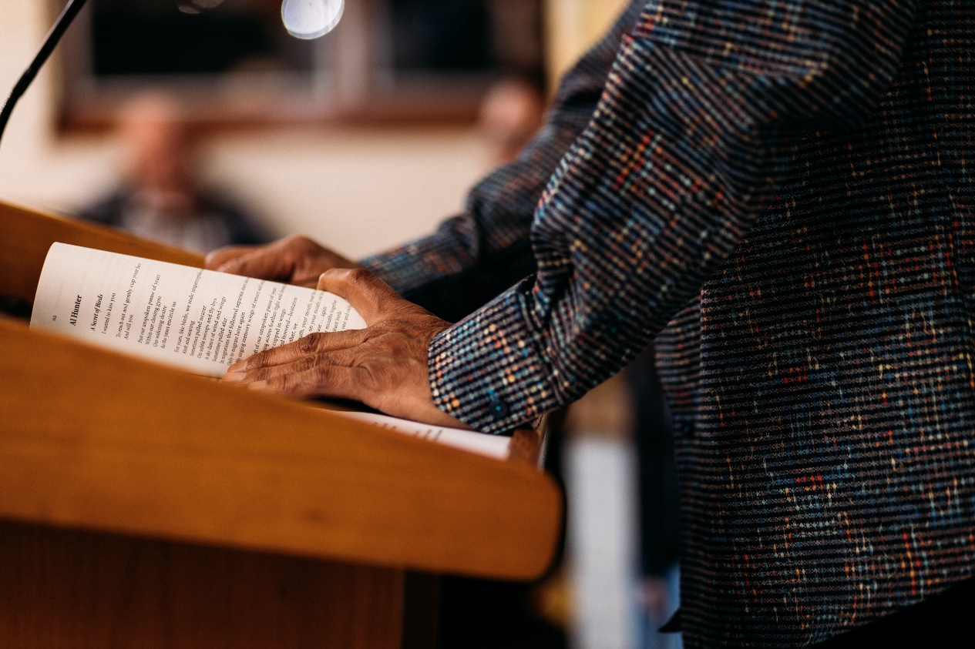
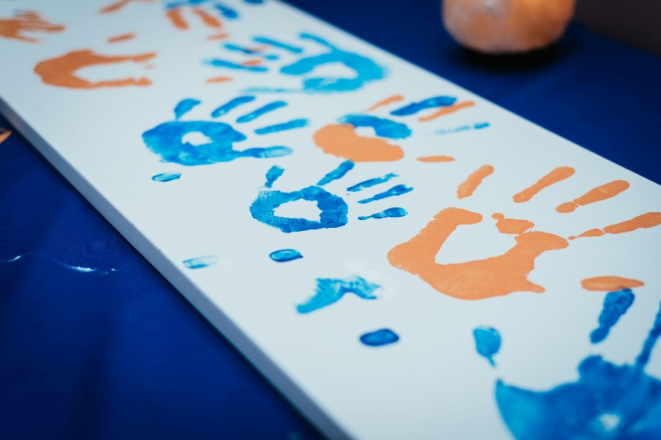
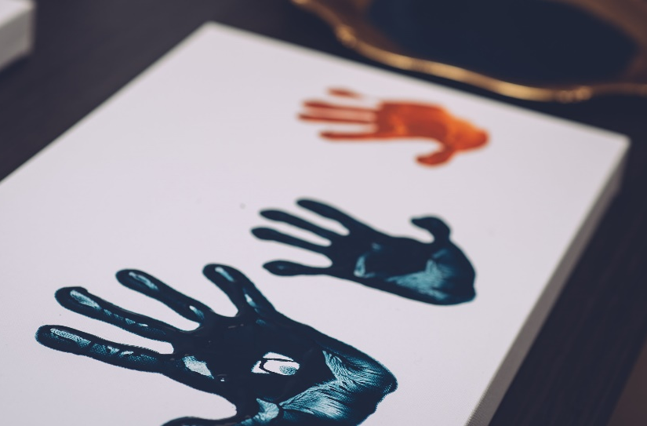
Strong Hands Stop Violence
Poetry Night/Poetry Book
Notes:
Strong Hands Stop Violence - Poetry Night/Poetry Book (share the name)
(every November 25)
ONWA hosts an annual event on November 25, 2019 which is the UN International Day to the Elimination of Violence against Women. This event allows community to express themselves through poem and story. During this event there is also a portion when we ask participants to share their painted handprint to create awareness and support the message in an effort to stop the violence. This event incorporates oral, written, and visual art.
Poetry Night is held Nov 25 (UN Day for the Elimination of Violence Against Women) in support of the day and of the start of the #orangetheworld campaign (UN initiative of 16 days of activism against gender-based violence around the world)
Poems submitted are published in book, released at following year’s event

Slide 14
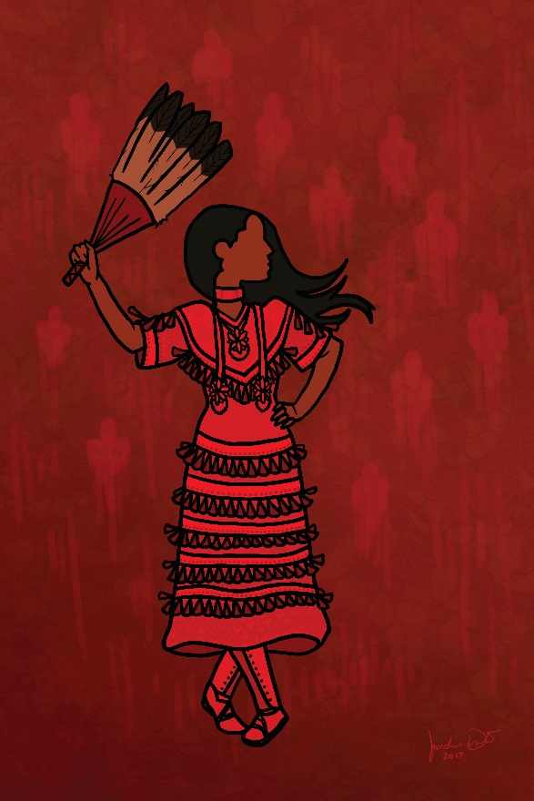
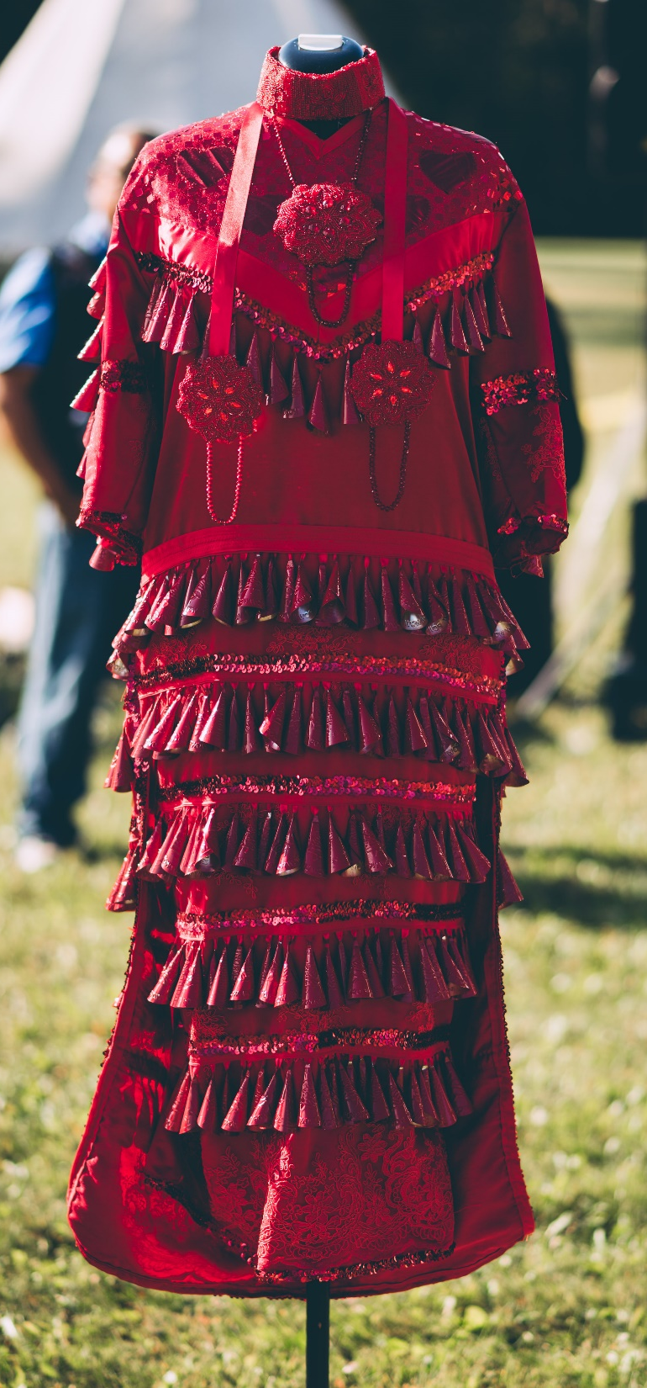
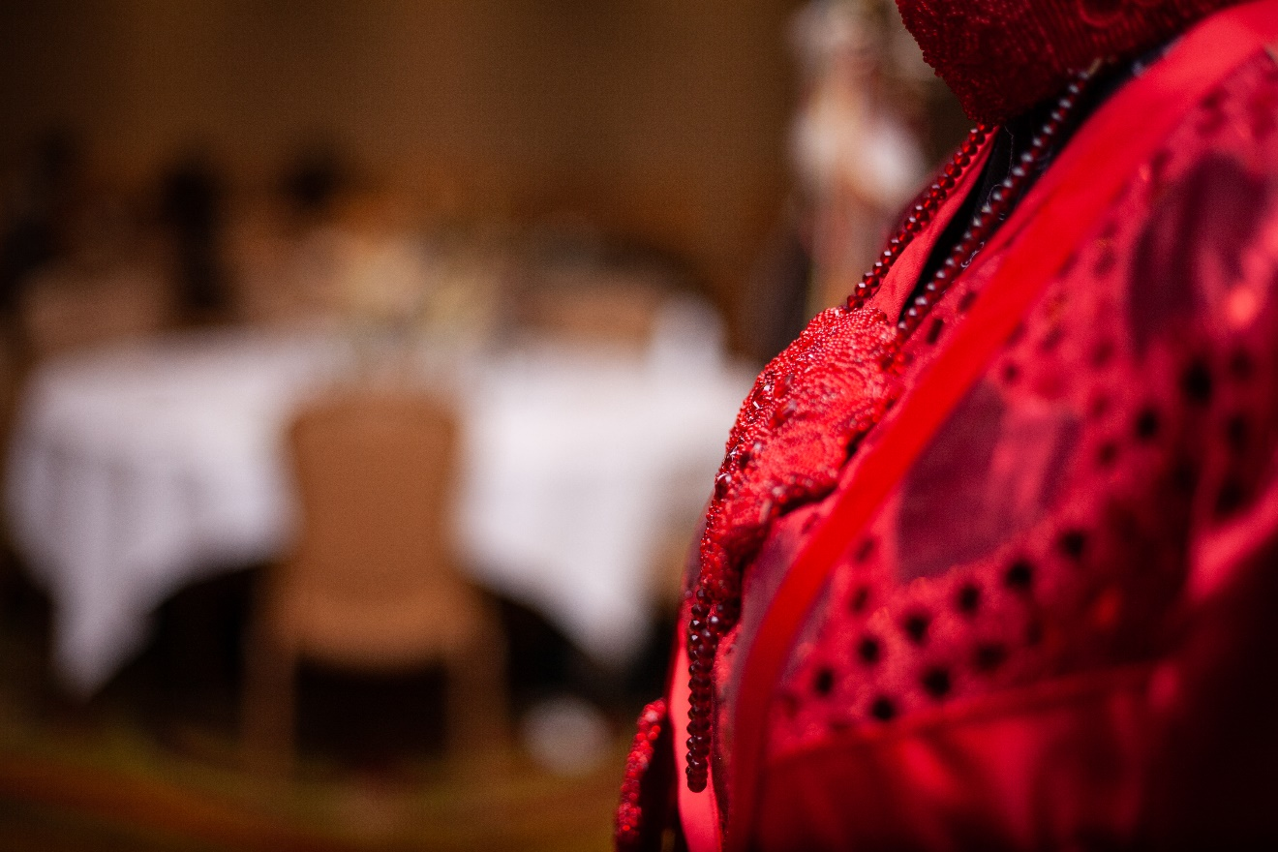
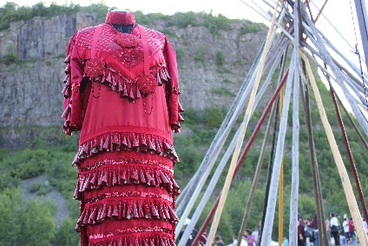

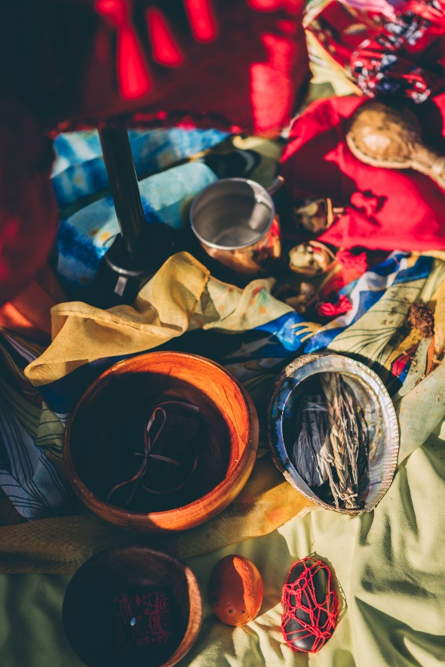

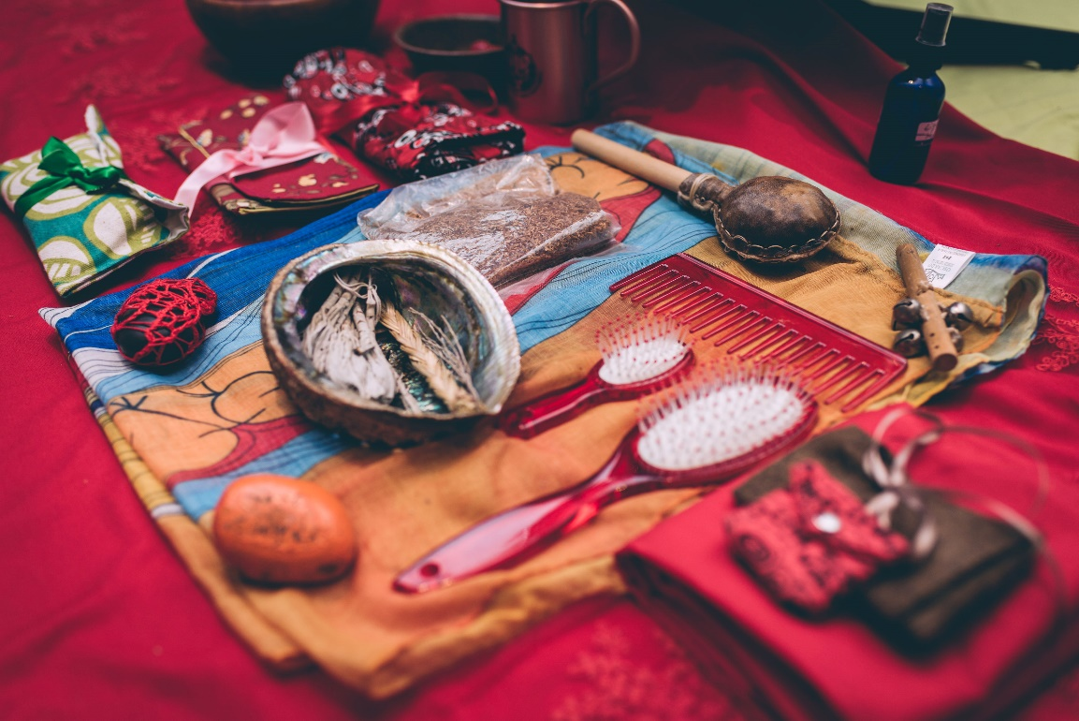
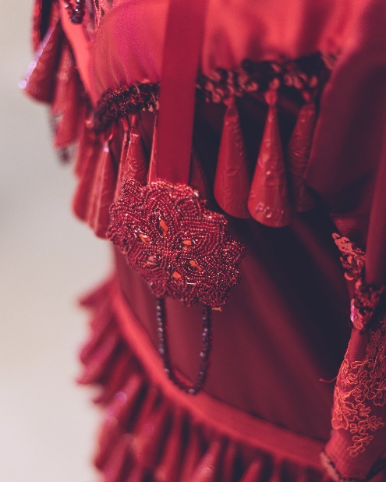
Grandmother Earth Dress
Notes:
Grandmother Earth Dress
The Grandmother Earth Dress is a part of ONWA’s Bundle, she was brought here through vison and ceremony. The Grandmother Mother Earth Dress is a healing dress that family members have been able to connect with and continue their healing paths.
The main purpose of the dress is to honor and acknowledge Murdered and Missing Indigenous women and girls. Second, the dress is to serve as a sacred item of healing for families as well as communities to commemorate their loved ones. She is meant for families to visualize their loved one in a beautiful traditional regalia
The dress has 365 jingles representing that Indigenous women are confronted with violence every single day of the year on Turtle Island. The dress will be travelling throughout the province to be there for other families and communities. The dress is never meant to be worn in this realm but is symbolic of women in the spirit world.
‘She Dances … and they dance with her’ artwork (by Jordis Duke)
Unveiled Dec 4 2018 she was intended for families has a healing tool, as well served as a reminder to the commissioners that the stories of these women are to be treated with respect and kindness as they are sacred
The Ontario Native Women’s Association fulfilled our inherent role as women and utilized a 3 part community action plan:
Preparing community – transparency with community services to community – this required building relationships within community,
Mobilizing and meeting the needs of community,
And ensuring aftercare and safety planning.
At the forefront to begin healing was engagement with community. This process needs to occur to be proactive in mobilizing a community action plan to bring together our community partners.
This strategy began with connecting with Elders and community Knowledge Keepers for use and protocol of traditional healing and ceremony and included other service providers such as; crisis response, addiction and mental health services, child welfare services, police, and medical services.
This approach ensured accountability, awareness, and transparency to provide services that were readily available for a seamless service continuum of care practice.
Institutional-based intergeneration trauma maintains the disruption to the relationships of family disconnection, the natural transfer of traditional knowledge of land, healing, community, and self.
The Ontario Native Women’s Association has observed a common reflection….the families have consistently stated they needed a place to grieve and to identify the inter-connection of their multiple loss including identity, culture, and self-location.
By providing Indigenous women, their families, and community with a safe, respectful space to honour and acknowledge their loved ones, we as a community create an opportunity to heal.
The Ontario Native Women’s Association’s MMIWG strategies have led to community initiatives and events that create a safe space for healing, culture, and to bring family and community together:
Community Gatherings
Traditional Healing and Ceremony
The Red Dress; her voice continues to carry in the Province of Ontario, to across Canada, and now across the world to Sydney, Australia.
MMIWG Call for Submissions - to complete report outside of the National Inquiry based on community needs and the need for systemic changes to occur
AVFL that continues to support women and families of MMIWG
The Ontario Native Women’s Association hosted the 3rd annual MMIWG Powwow this fall 2018. This event continues to be successful due to being inclusively led by Indigenous women and community at a grassroots level. Only by involving Indigenous Women and amplifying their voices we further empower women to take back their roles as leaders, and more importantly as medicine.

Slide 15
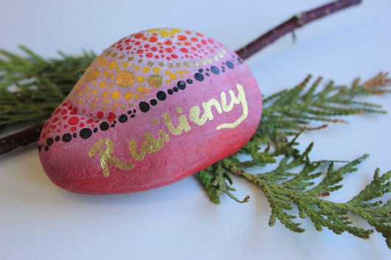
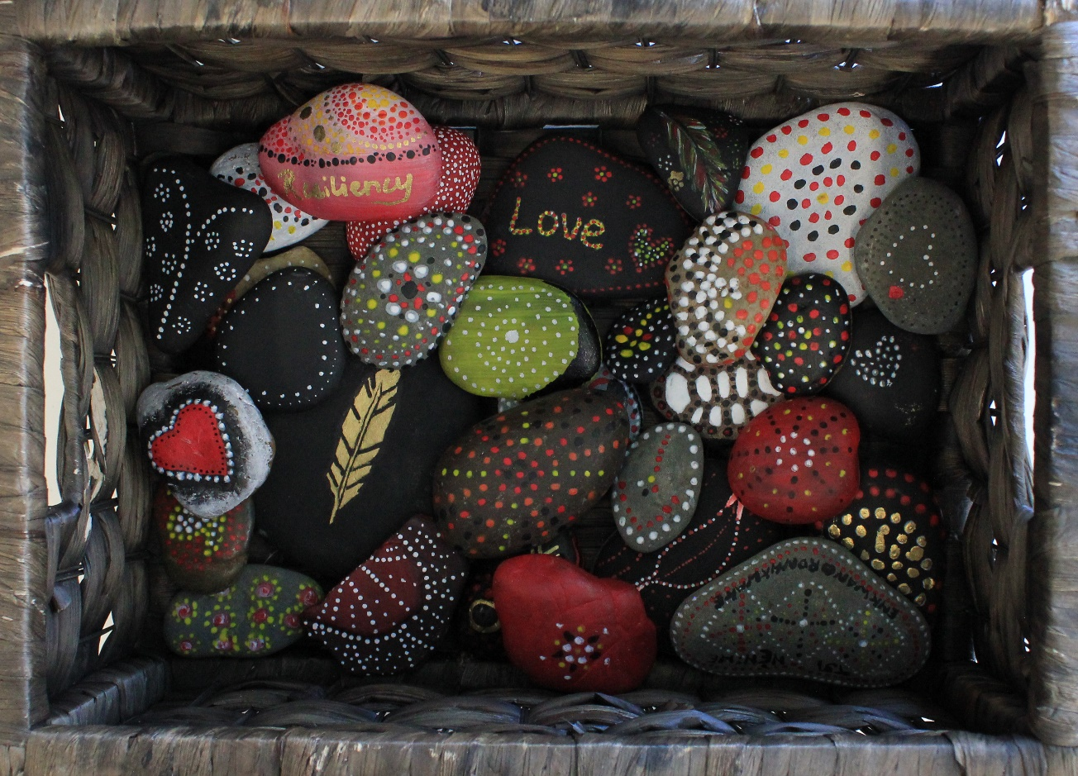
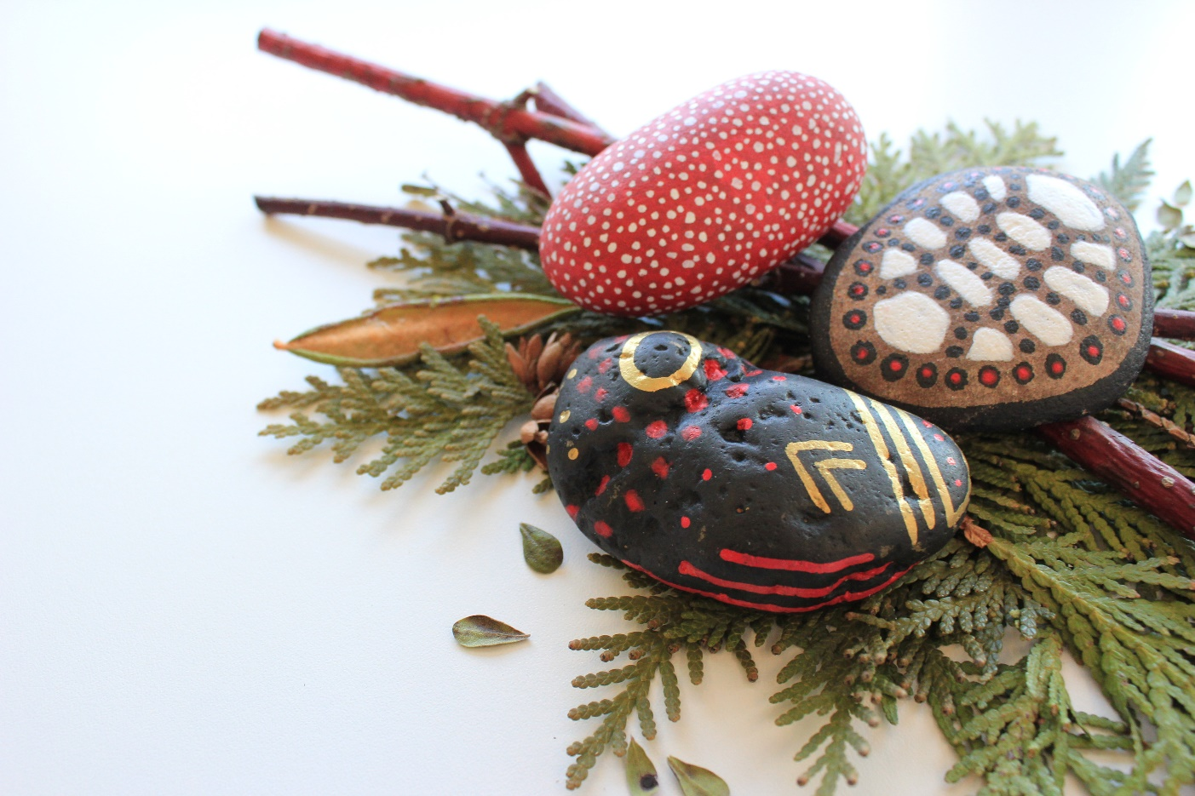
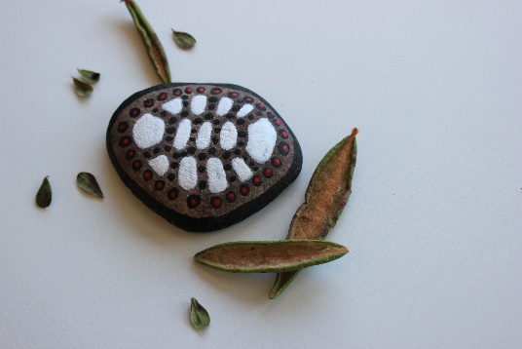
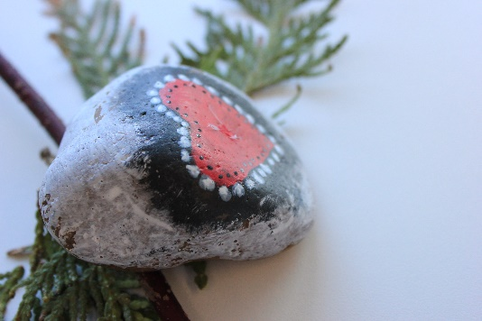
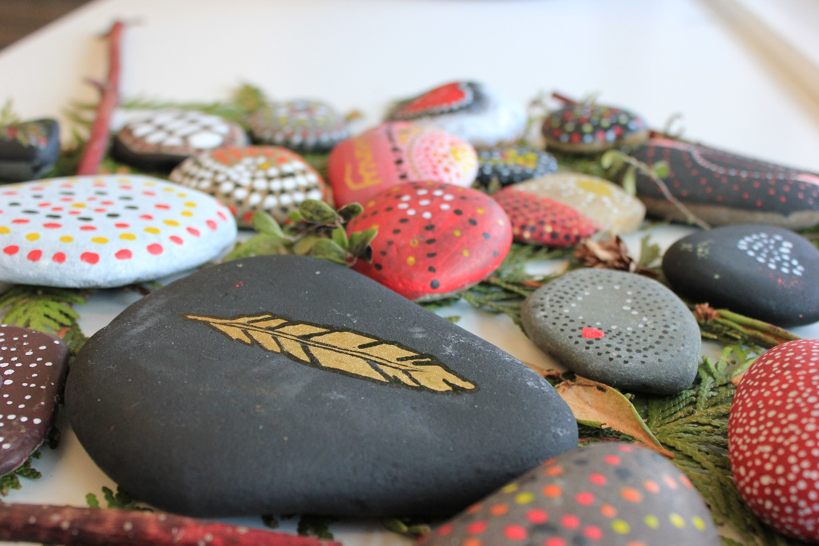
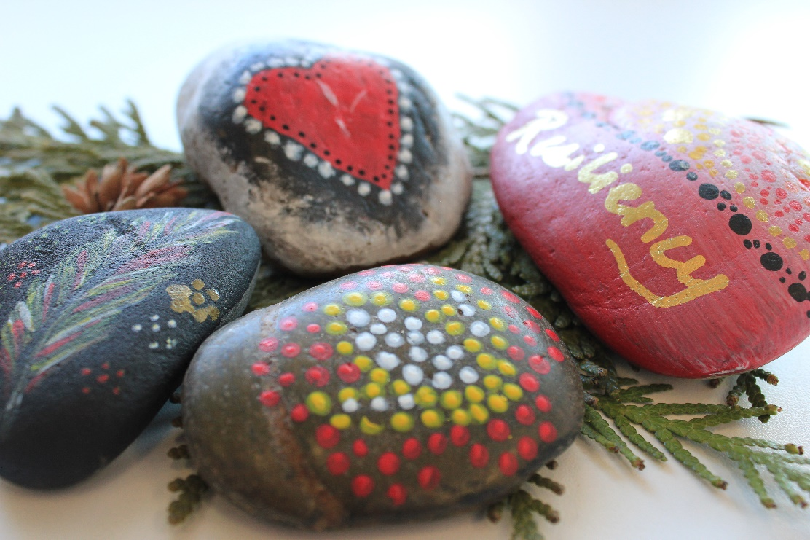
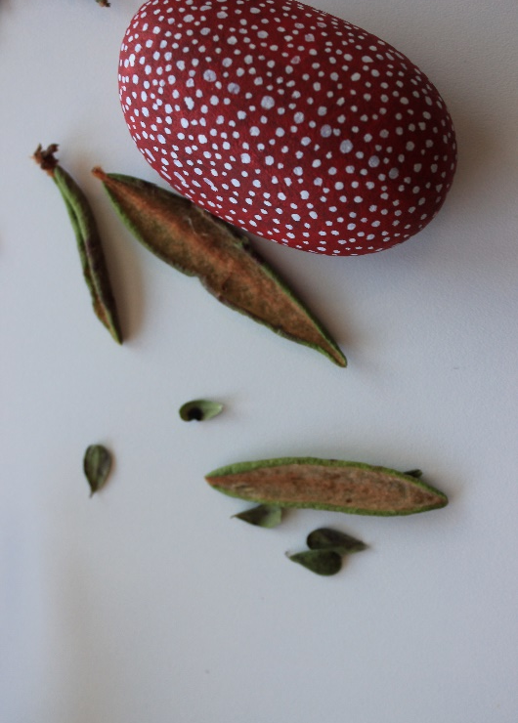
Mandala Rock Project
Notes:
Mandala Rock Project:
The Mandala rock painting exercise is an activity that uses art therapy to honour MMIWG2S
Each dot on the rock is to symbolise and honour positive memories or attributes of women that have been or are missing and murdered.
The Mandala rock project encourages loved ones to then place the rocks somewhere sacred or special to commemorate the memory of their loved one.

Slide 16
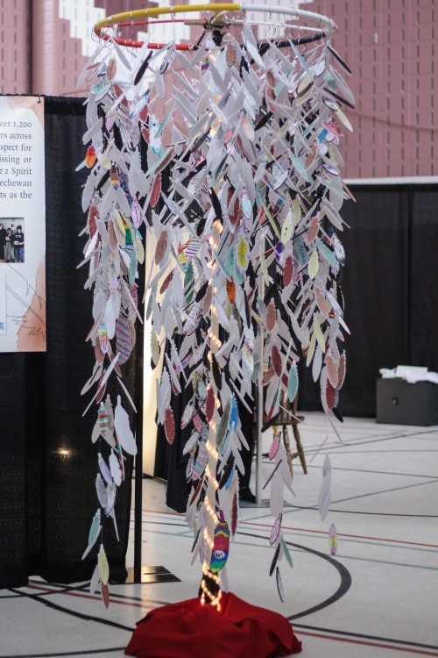
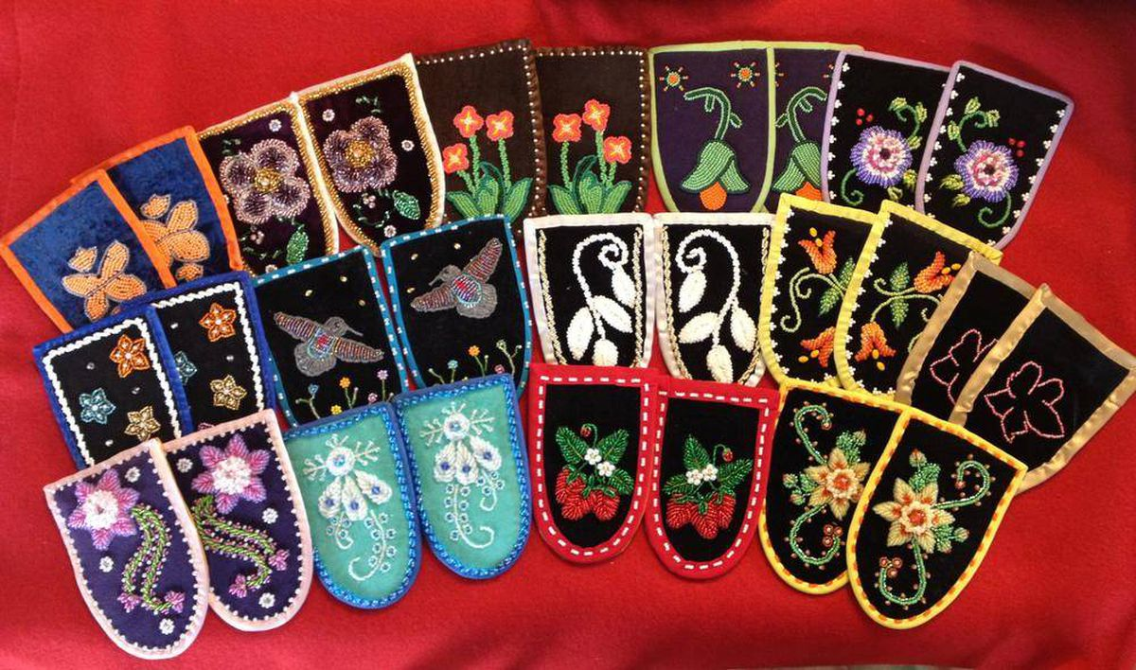
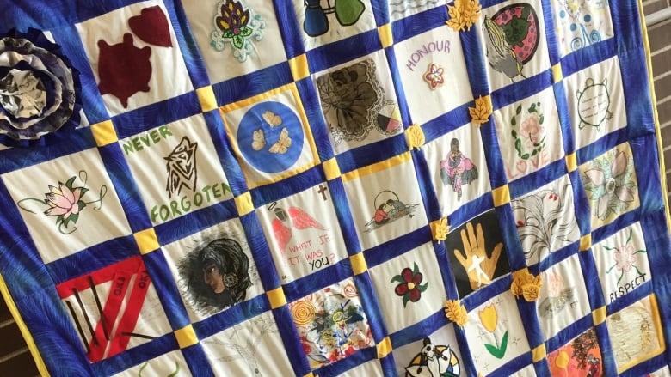
Inspiration
Shades of Sisters (2017)
Walking with Our Sisters 2013-2019
Quilt Making - ONWA Sacred Tree Program 2013

Slide 17
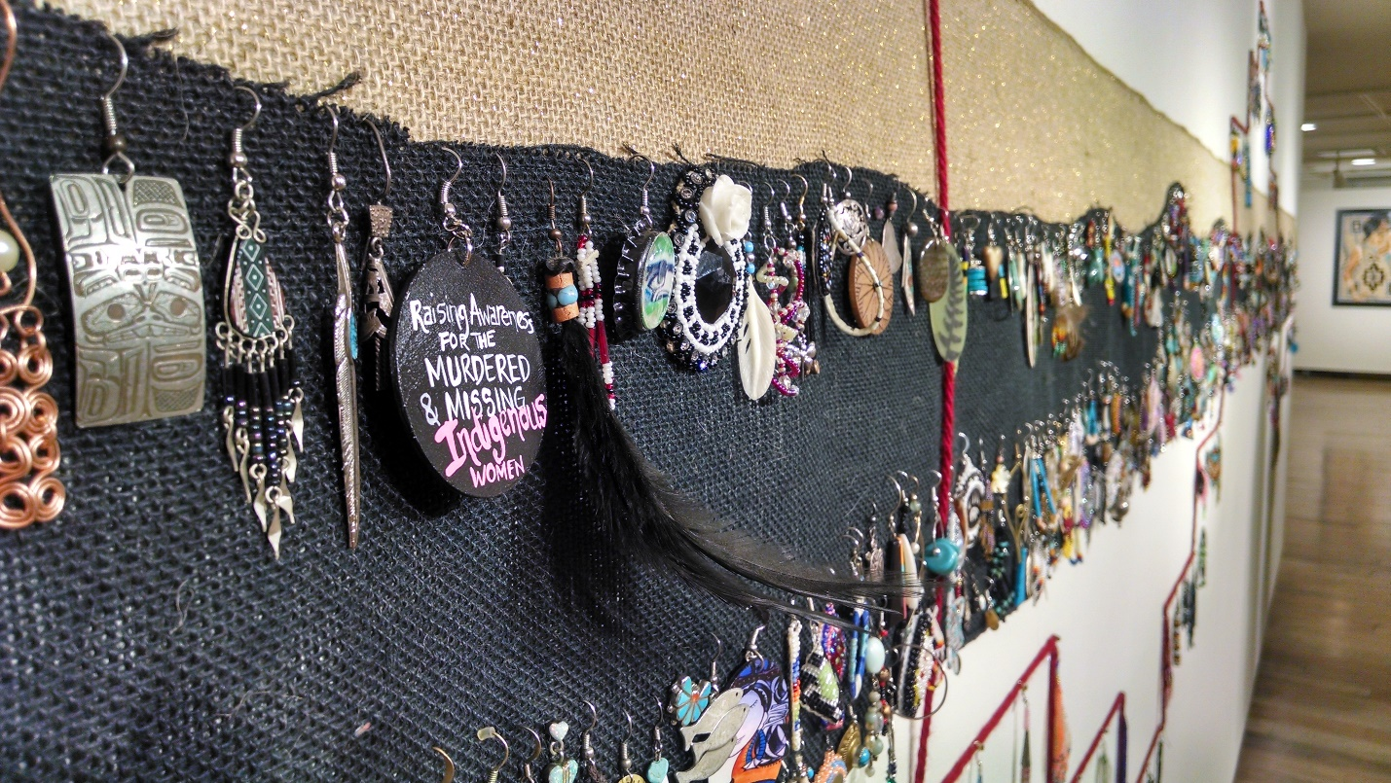
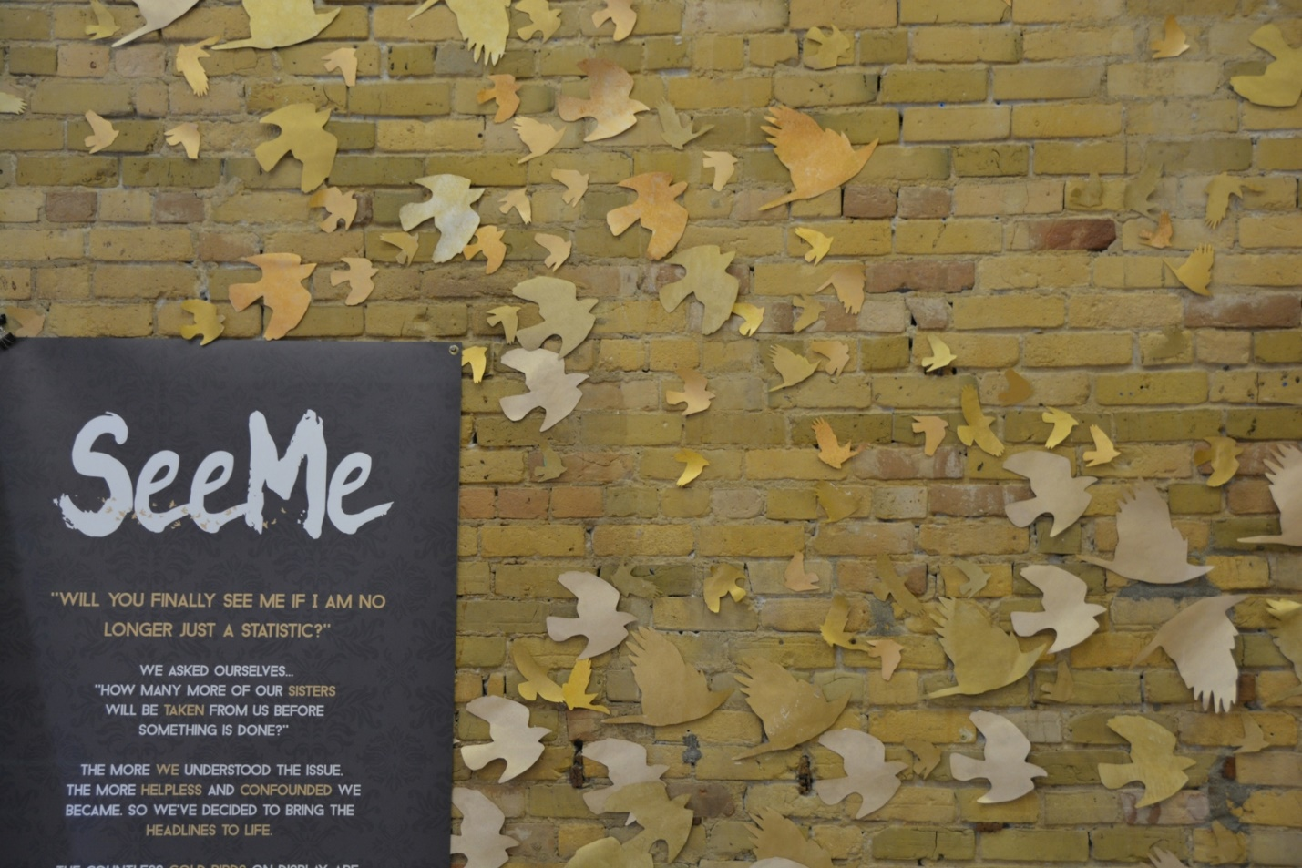
Inspiration:
Sing Our Rivers Red - Earring Exhibit 2015
See Me 2015

Slide 18
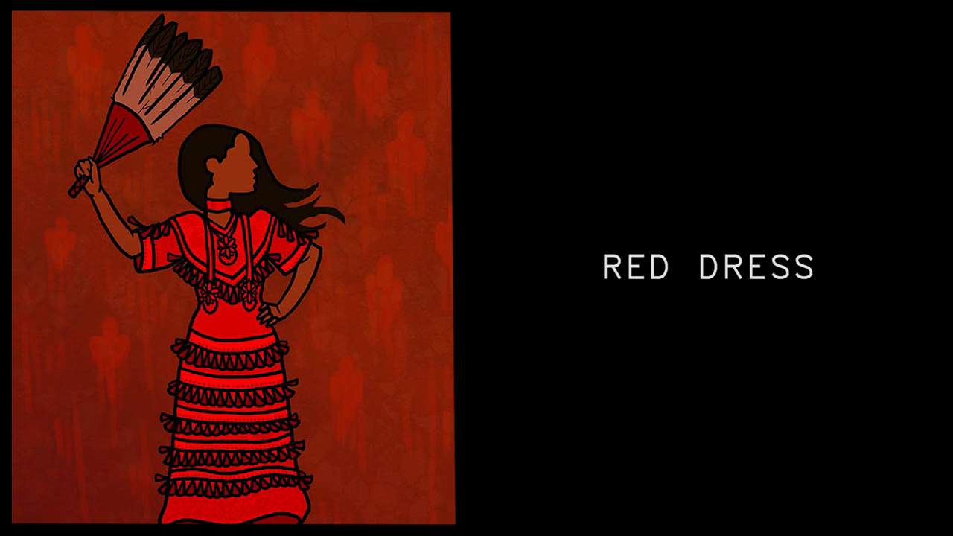

Slide 19
Medicine Lines of Womanhood:
ONWA MMIW Commemorative Project

Slide 20
Indigenous Arts-based Approaches
Indigenous arts-based approaches are diverse and can include beading, painting, photovoice, storyboards, quilting, performance, and music.
This project will had two skilled women assisting the participants through the arts-based healing experience.

Slide 21
Medicine Lines of Womanhood: ONWA MMIW Commemorative Project
The Ontario Native Women's Association (ONWA) Medicine Lines of Womanhood project is intended to be a series of commemorative art exhibits that honour the lives of Missing and Murdered Indigenous Women and Girls (MMIWG).
The project encourages public education and awareness by acknowledging the loss and grief that families continue to endure.
The project will be captured digitally and launched virtually and in person in 2022.
When the pandemic allows, there will be in-person exhibits hosted in different cities throughout Ontario: Target communities will be Thunder Bay, Ottawa, Kenora, and Sioux Lookout.
Notes:
OBJECTIVE:
ONWA hopes that the collective and diverse arts-based approaches for each regional exhibit will create a unified voice for MMIWG and their families. The collaborative Indigenous arts-based approaches will be self-determined by the families in each region, to honour their ways of sharing and telling stories about their loved one.
This project is also intended to be educational for both Indigenous and non-Indigenous communities. We know that MMIWG are more than the headlines and statistics too often presented in mainstream reports. The Medicine Lines of Womanhood exhibits will humanize Indigenous women through visual representations of their significance to their families, communities, and Nations.
Project Outline
Each participant will be invited to up to 5 sessions, this includes the introductory session, 4 art based sessions and closing session.
The introductory session and the closing session will include all participants
The other sessions will include smaller assigned groups
Each session will have an elder, knowledge keeper or support person in attendance to support the participants
Each session will have a Arts based facilitator
All art materials will be mailed to participants for the two art pieces
One of the two pieces created will remain with the participants and one will become part of ONWA’s MMIWG Art Collective
We ask that all art pieces be part of the digital

Slide 22
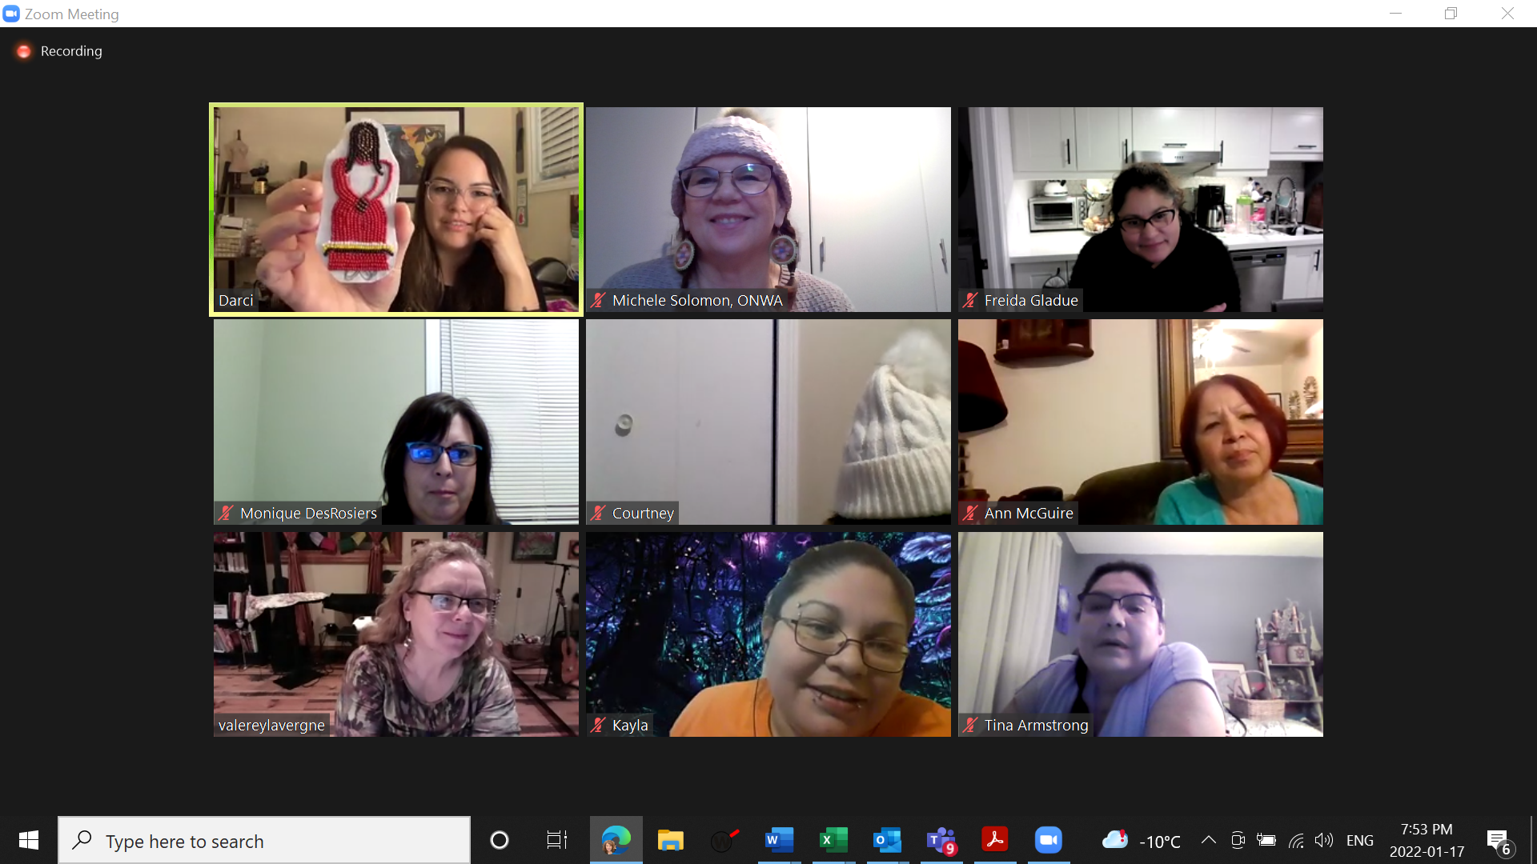
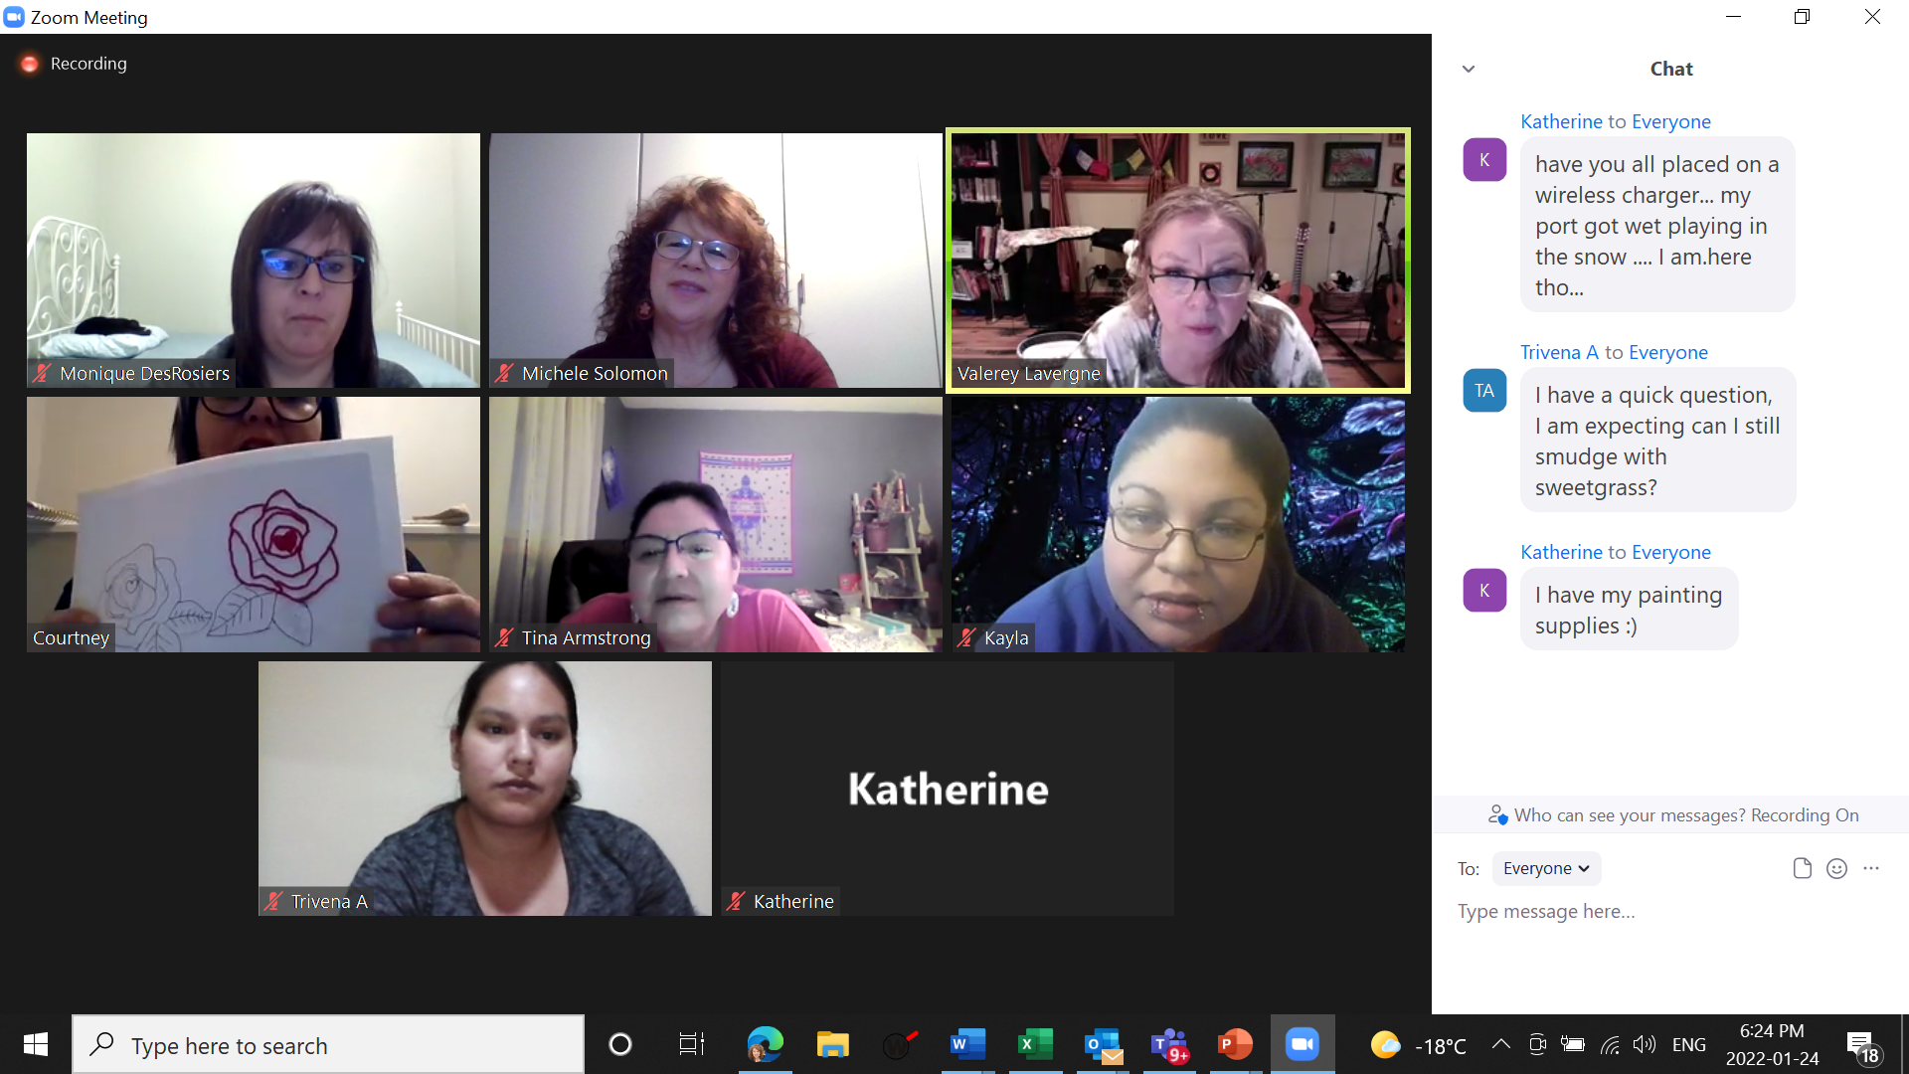
Zoom Session

Slide 23
4 Key stages of the project
East – Safety
South – Justice
West – Honouring
North – Healing

Slide 24
Miigwetch
Questions?

